Slide 1


Broadspire and CaseGlide – the claims litigation management solution for your success

Slide 2
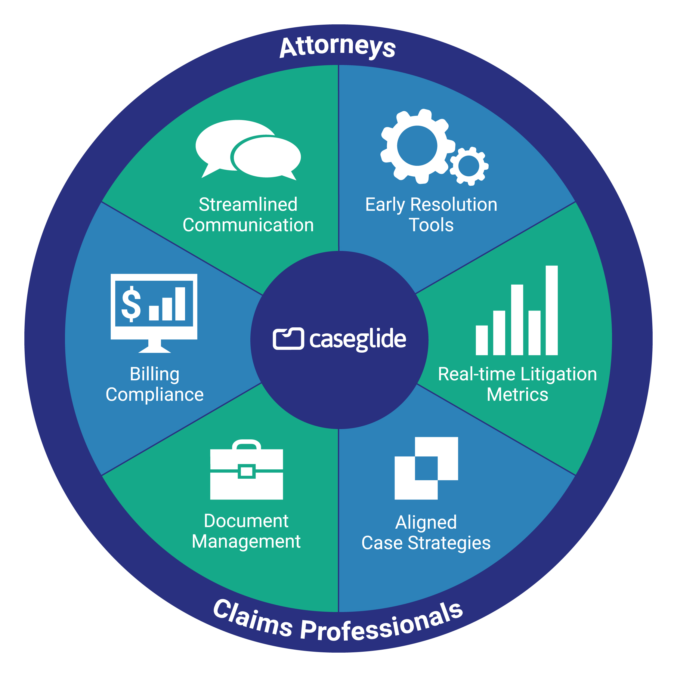

About CaseGlide
CaseGlide is the industry’s only truly collaborative software platform where attorneys and Broadspire claims professionals work together to resolve litigated files more efficiently, more quickly and with better outcomes.
You benefit from faster case closures, improved defense attorney alignment, and legal fee and indemnity savings. CaseGlide’s reporting engine also provides you unparalleled access to program data and metrics.

Slide 3
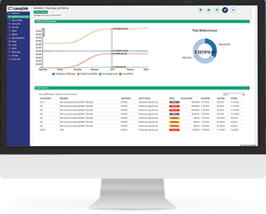
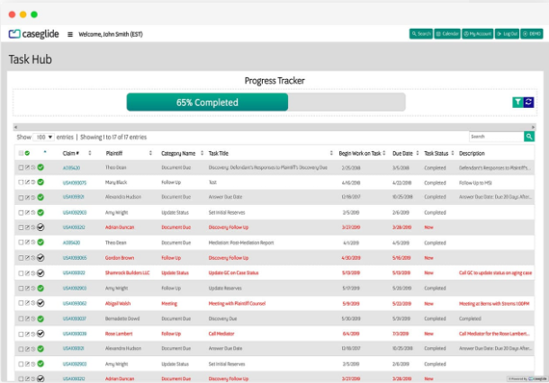
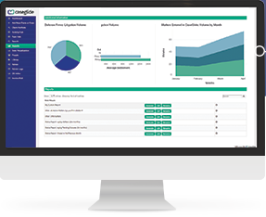
Matter Management and Workflows
One Unified System
The CaseGlide system aligns your prescribed workflows with your attorneys’ work, ensuring all parties are working closely together and on task
Broadspire claims professionals and attorneys work directly in the system, storing documents centrally, scheduling important events and no longer having to rely on email
All the data and transactions are captured and reportable, offering you and your Broadspire team access to results, key program metrics and dashboards
You benefit from more efficient processes, fast case closure, and decreased legal costs and indemnity

Slide 4
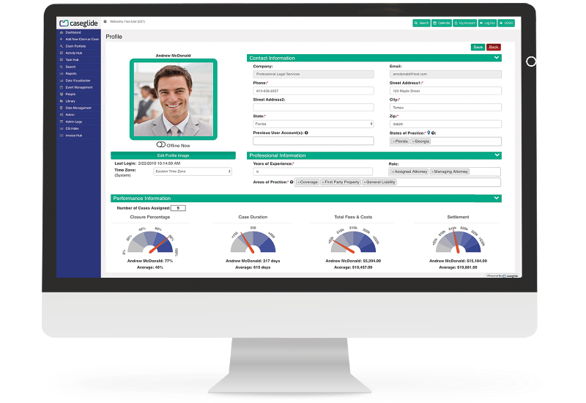
Attorney Scorecards
Insight into Performance and Expense
Attorney performance is tracked throughout the case lifecycle – including costs, duration and Broadspire claims professionals’ feedback
You and your Broadspire claims team can make attorney selection decisions with clarity - Identify and properly distribute cases to attorneys excelling at closures, expense management and settlement amounts
You benefit from knowing that attorney selection is based on data and results, helping to reduce unnecessary legal fees and poor outcomes

Slide 5

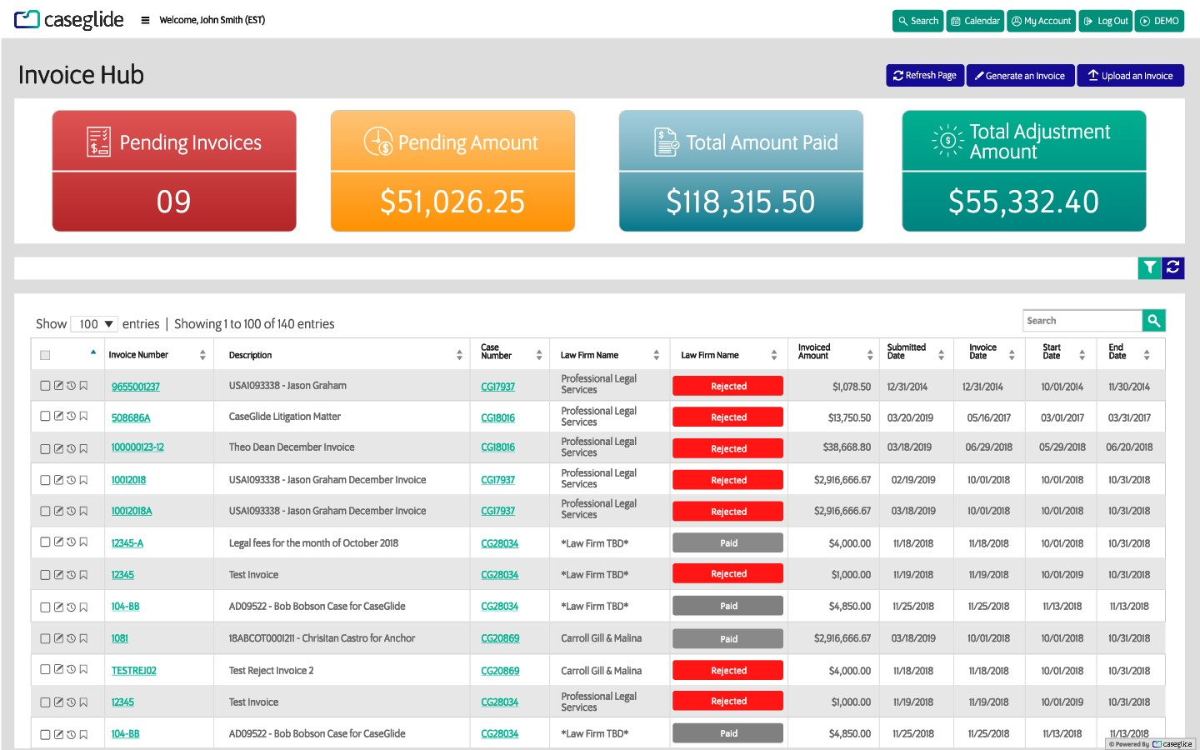
E-Billing and Legal Bill Review
Legal Spend Control and Compliance
CaseGlide approves invoices compliant with your guidelines and flags or automatically adjusts non-compliant invoices
The system includes a fully configurable rules engine for reviewing your attorneys’ invoices for compliance with your billing guidelines
You can realize substantial fee savings and actionable intelligence that helps you make better, more informed claims program decisions

Slide 6
How does it integrate?
CaseGlide and the Broadspire Claims System:
CaseGlide is integrated with Broadspire’s Claims technology where CaseGlide passes file information, documents, notes and other important data to the claims system case files
There is no redundant data entry for Broadspire claims professionals, allowing for even greater efficiency gains

Slide 7
Getting Started
Addendum and Go-Live
We’ll work with you and Broadspire to create a simple addendum to your existing Broadspire contract to begin work with CaseGlide
Billing is easily handled - CaseGlide fees are an allocated expense and charges are managed between CaseGlide and Broadspire accounting
We’ll handle all the implementation steps:
Build out of workflows
Creation of attorney users/outside panel
Training for Broadspire claims personnel and attorneys
Configure platform, data import (if any), set up of rules and e-billing system
Conduct testing kickoff/training and monitor feedback from UAT testing

Slide 8
How do Attorneys feel about CaseGlide?
“CaseGlide has been a game changer for our team. Documenting client communication can often be time consuming, but the CaseGlide platform makes it seamless and organized. No matter if the case changes hands within the firm or the client, there are no interruptions or lost records.”
Hope Zellinger | Partner | Bressler Amery Ross
“Bottom line: CaseGlide offers a platform which allows us to communicate effectively with our clients
throughout each legal struggle until the battle has ended. Plus, CaseGlide provides our insurer clients with advanced metrics, trends, and statistics that are unparalleled in the defense market.”
Tom Diana | Partner | Zinober Diana
“CaseGlide’s legal spend management platform helps me manage my litigation with my clients … CaseGlide quiets a lot of the “noise” in litigation so my team can focus on getting cases closed for our clients.”
Aram Megarlan | Partner | Cole Scott & Kissane

Slide 9
How do Attorneys feel about CaseGlide?
“Whether the client is submitting a rate filing, responding to a data call, dealing with regulators
and auditors, or running a claims or litigation department, the story is told through the numbers. How does a client get that information? CaseGlide. How does a client identify leakage in claims and litigation? CaseGlide. What is a defense lawyer’s best management tool? CaseGlide.”
Kim Salmon | Partner | Gorelle & Salmon
“CaseGlide has changed the way I practice law. It improved communication, but CaseGlide offered a lot more. The ability to generate reports across all my firm’s cases, the ease with which I can track case activity; and CaseGlide’s use of key analytic metrics changed the way we practiced. It has allowed my firm to shift internal resources to defensible cases, quickly settle the claims that should not be litigated, and keep fees lower than before we had this data available. “
Jason Wolf | Shareholder | Parafinczuk Wolf Susen

